Slide 1
Team Bugminators
TEAM MEMBER 1:
Anshika (Team leader)
12113011
2nd year
TEAM MEMBER 2:
Abhay Rawat
12113063
2nd year
TEAM MEMBER 3:
Aanchal
12113069
2nd year
Institute : National Institute of Technology, Kurukshetra

Slide 2
Problem statement
Creating technology solutions to improve patient outcomes. The goal is to develop innovative technology solutions that can improve the quality, accessibility, and affordability of healthcare for patients.

Slide 3

Clinic Buddy

Slide 4
TABLE OF CONTENTS
01.
02.
03.
04.
Problem statement
Flowchart and functionalities
Use cases
Future scope

Slide 5
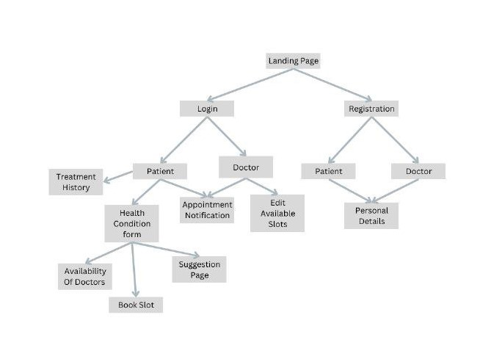

Slide 6
1):1st page will be login page or registration page which will check whether the user is a patient or a doctor and according project them to their specific dashboard.
Patients Dashboard:
1):On the patient dashboard their will be a form in which he/she can fill the symptoms.
2): Patients can see the list of doctors.
3): All the test reports will be saved.
4): Personal detail.
Doctor Dashboard:
1): Details of the Doctor with their specified field will be shown.
2): They can fill their available slots at the time of registration and it will be shown .

Slide 7
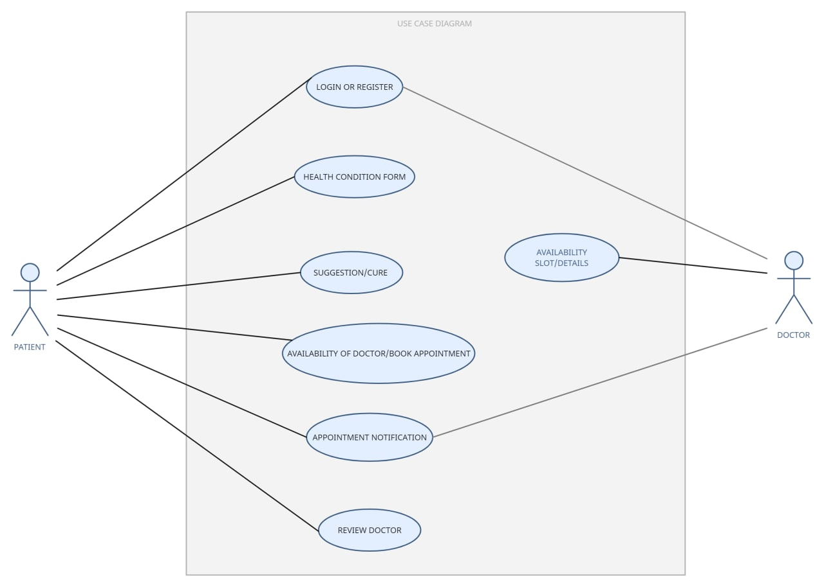
PATIENT:
Login or register on the website.
Fill out a health condition form.
A list of doctors with their time slots will be displayed from which the patient can book a suitable appointment.
The patient can also rate the doctor according to his/her experience.
DOCTOR:
1. Login or register on the website.
2. Enter personal details, specification area, hospital/clinic working in, availability slots, etc.

Slide 8
Future scope:
: Patients can pay online through website itself.
: Appointment Notification.
: After the uploading of the prescription a reminder will be send to patient to take the specified medicine.

Slide 9
THANK YOU

